Slide 1


Geography
of Canada
SS6G5 & SS6G6 Physical Features, Where People Live, & How They Trade

Slide 2
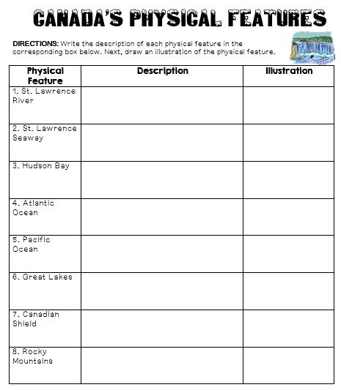

Slide 3
Physical
Features

Slide 4
Great Lakes
5 large freshwater lakes in central North America
  HOMES (Huron, Ontario, Michigan, Erie, Superior)
Serve as the “industrial heartland” of the continent because of all of the factories
One of the world’s busiest shipping areas
  Most of Canada’s population lives in this region

Slide 5

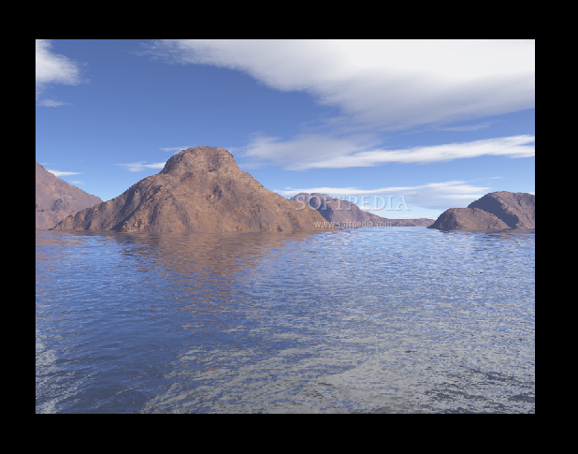

Slide 6
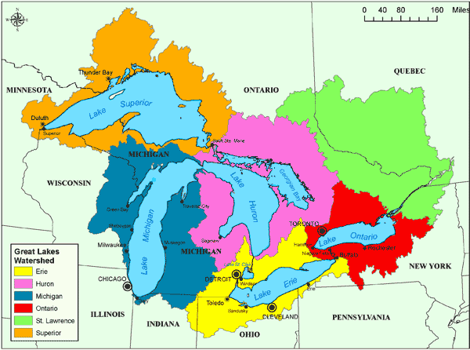

Slide 7
St Lawrence River
Major source of overseas and US/Canada shipping & trade
  Shortcut that connects the Great Lakes to the Atlantic Ocean
Huge producer of hydroelectricity

Slide 8
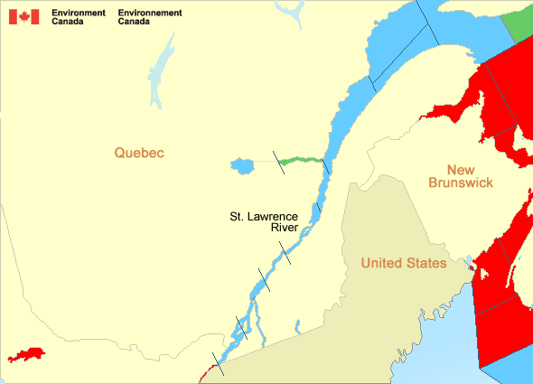

Slide 9
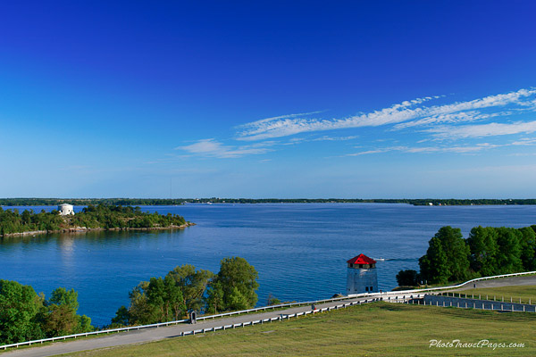

Slide 10
St Lawrence Seaway
A canal completed in 1959 at the eastern end of the Great Lakes
  Connects the Great Lakes with the St. Lawrence River (which flows to the Atlantic Ocean)
Major source of overseas and US/Canada shipping & trade
  Closed from November to April (frozen)
  Seaway has made cities in Eastern Canada home to many successful manufacturing companies

Slide 11
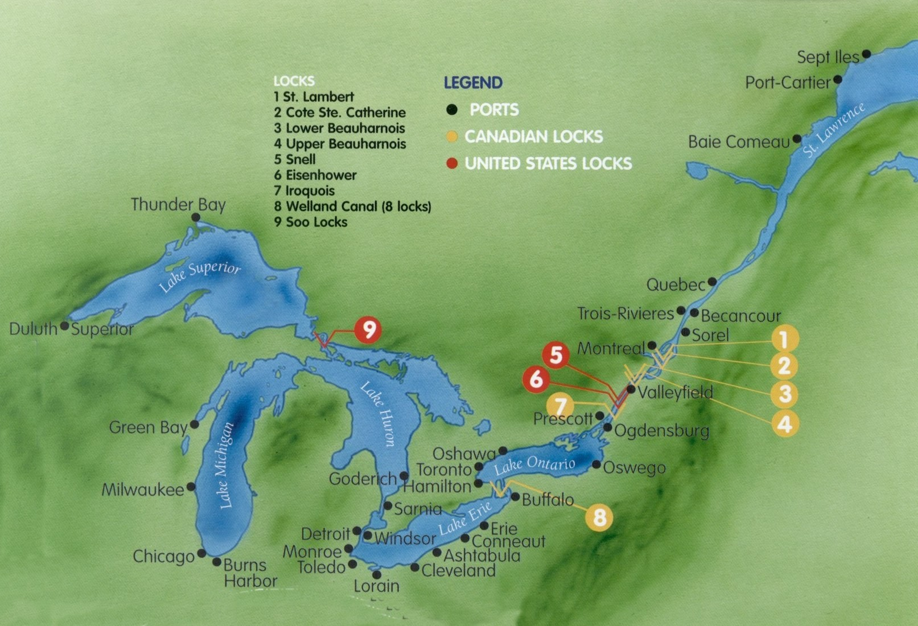

Slide 12
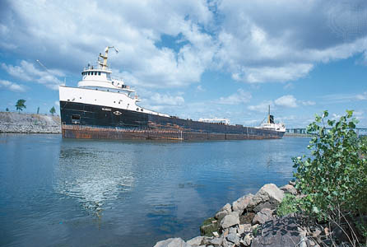

Slide 13
Hudson Bay
HUGE inland sea in east central Canada
“an arm” of the Atlantic Ocean
  Grain from Alberta & Saskatchewan is shipped from Hudson Bay out to the Atlantic and on to other countries
  Only navigable from July to October

Slide 14
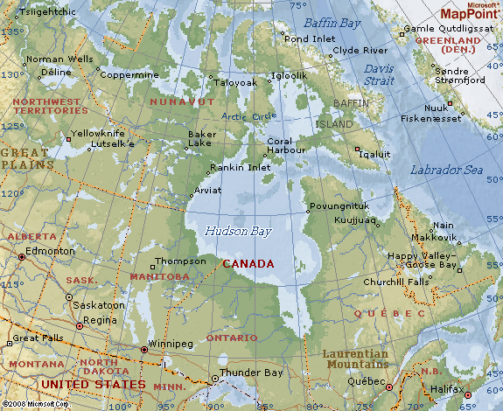

Slide 15
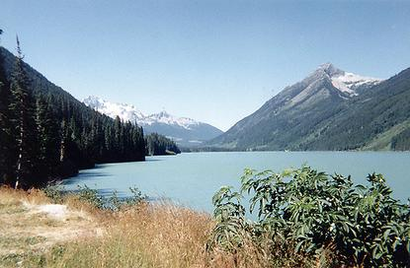

Slide 16
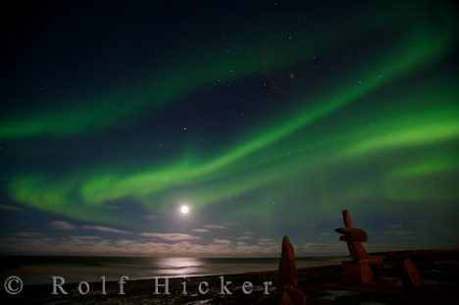

Slide 17
Atlantic Ocean
This is the 2nd largest of the earth’s 5 oceans.
It’s also the most heavily traveled ocean.
It forms the eastern border of Canada.
  It’s a major shipping route to Europe & Africa.

Slide 18
Pacific Ocean
Largest & deepest of the world’s 5 oceans
Covers 1/3 of the earth’s surface!
Western border of Canada
  Major shipping route to Asia

Slide 19
Canadian Shield
Stretches from Great Lakes to Arctic Ocean; covers half of Canada!
  Horseshoe region around Hudson Bay
Region of mostly thin soil lying on top of rock, with many bare outcrops of rock & thousands of lakes
Major source of natural resources: timber, minerals, & water
Region is sparsely populated.

Slide 20
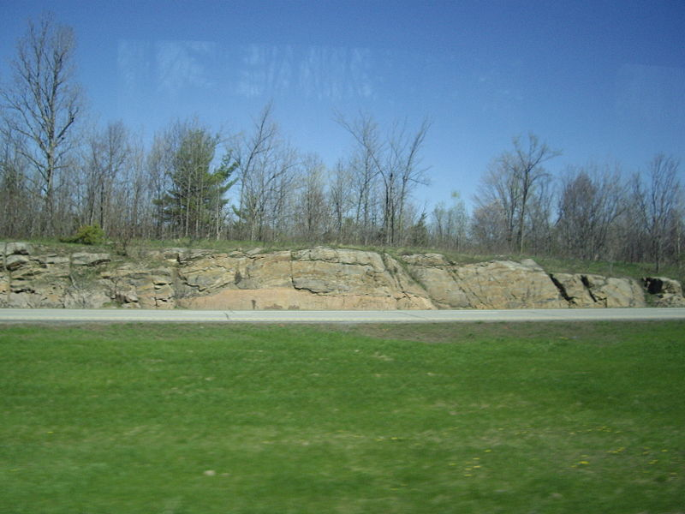

Slide 21
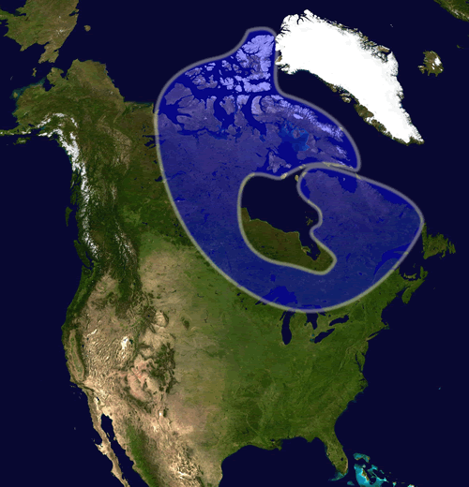

Slide 22
Rocky Mountains
Mountains located in Western Canada
  Includes western Alberta and eastern British Columbia
Stretch a distance of 2,000 miles!
Mining is the biggest industry in the region, followed closely by logging.
  Major minerals include: iron ore, copper, coal, gold.
Sparsely populated & contain few cities

Slide 23
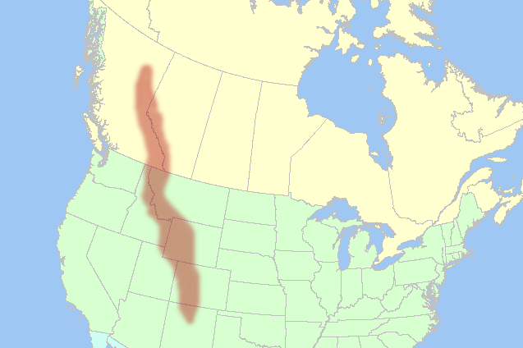

Slide 24
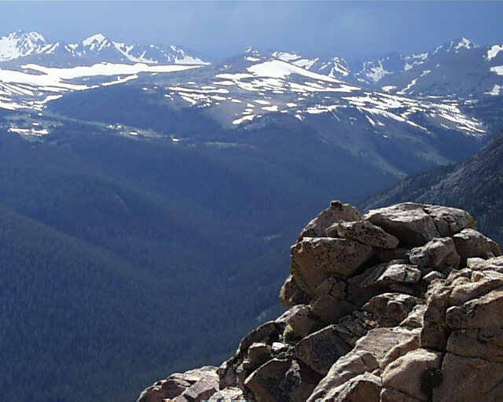

Slide 25
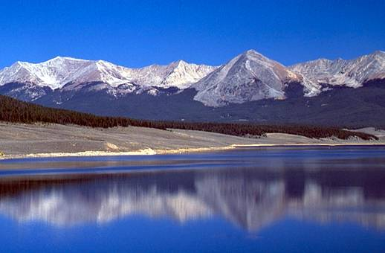

Slide 26
Be the Thing…
Your Task:
  Choose 1 of the physical features
  Fold your paper “hamburger style” to make a desk tent
On the front : Imagine that you are one of the features. Write 5 facts about yourself.
On the back: draw an illustration of the feature
We will walk around and try to guess the features!

Slide 27
Example:
Brrrrr! I am always so cold!! It’s chilly up here in northern Canada. I am so tired of everybody always picking on me. Dig, dig, dig all day long. I wish I had some pretty trees to look at…All that I can see is scraggly trees and flat, rocky land. It’s so lonely. No one lives near me.

Slide 28
Canadian Shield!

Slide 29
Where People Live
&
How They Trade

Slide 30
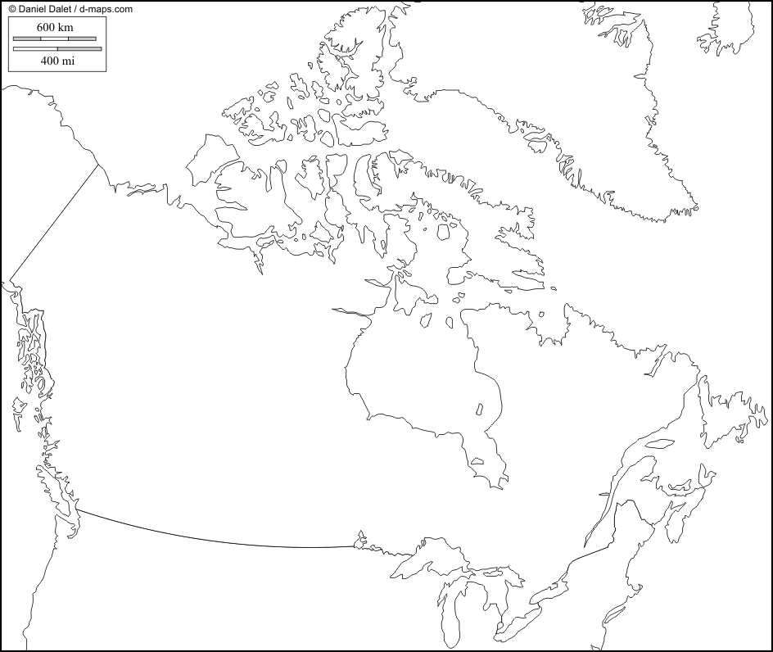
Let’s Review:
Physical Features

Slide 31

Location
2nd largest country in the world (Russia is larger)
Surrounded by three oceans: Atlantic, Arctic, & Pacific
Southern border is the US
  Alaska also forms part of the western border.
Population is 33 million, which is small compared to its size (US population is 9 times larger!)
  90 percent of population lives within 100 miles of the US-Canadian border…WHY?

Slide 32
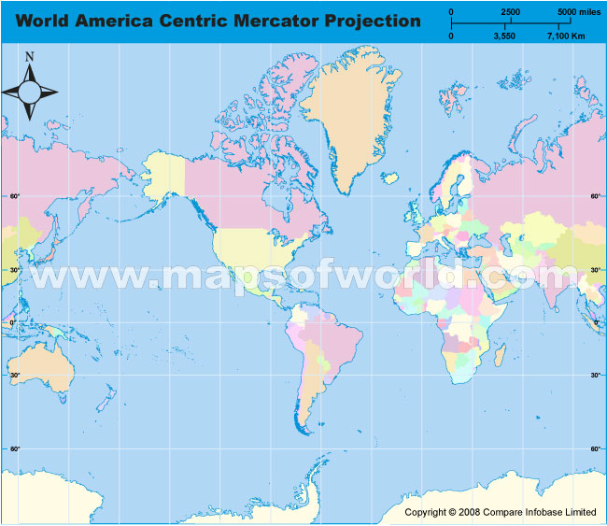


Slide 33
Location & Trade
Canada’s location in the world helps it to be a leader in world trade:
  It’s uniquely located on 3 oceans, so it has opportunities to trade with Europe & Asia.
  Great Lakes and the St. Lawrence Seaway allow goods to be shipped to and from central Canada and the Atlantic Ocean
  A major benefit for Canada is its border with the US (#1 trading partner).
    Share over 3,000 miles of border & trade is relatively easy
    80% of Canada’s exports come to US

Slide 34
Climate
Southeastern part of Canada has a MUCH warmer climate than the rest of the country.
  Warm to hot summers & cold winters
  Allows for a long growing season
Pacific coast has a temperate climate.
  Pacific ocean cools the region in summer and warms it in winter.
  Over 100 inches of precipitation per year
Northern Canada is COLD!
  Few people live here – temperatures can be below freezing even in summer!

Slide 35
Climate & Trade
Canada’s location in the world helps it to be a leader in world trade:
  It’s uniquely located on 3 oceans, so it has opportunities to trade with Europe & Asia.
  Great Lakes and the St. Lawrence Seaway allow goods to be shipped to and from central Canada and the Atlantic Ocean
  A major benefit for Canada is its border with the US (#1 trading partner).
    Share over 3,000 miles of border & trade is relatively easy
    80% of Canada’s exports come to US

Slide 36
Natural Resources
Rich in natural resources:
  coal, oil, natural gas, iron ore, nickel, zinc, copper, gold, lead, molybdenum, potash, diamonds, & silver
Rivers and lakes have an abundance of fish, fresh water, & hydroelectric power.
Good soil allows farmers to grow crops for Canadians--with enough left over to trade with other countries
Timber is also a major natural resource.

Slide 37
N.R. & Trade
Sells oil and natural gas, fish, agricultural products, & timber to other countries
Hydroelectricity is used in Canada and also sold to the US.
5% of the land in Canada is arable (actually a large amount because there is so much land).
  Rich soil produces valuable crops that are consumed in Canada and traded to other countries.

Slide 38
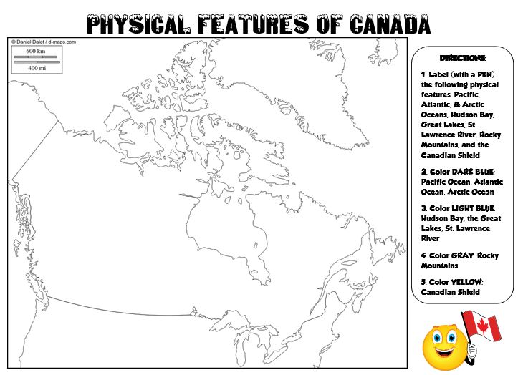

Slide 39

Pack Your Bags
Inside of the suitcase, draw FIVE things that you are going to take with you on our class trip to Canada.
    Think about the location, climate, physical features, and natural resources of the country. Look in your notebook for clues about what you might need on your trip.
Next, include a brief description of why you chose to bring that particular item.
Color your suitcase—be creative! ☺
    Example: I’m bringing a snowboard so that I can go down the Rocky Mountains!

Slide 40
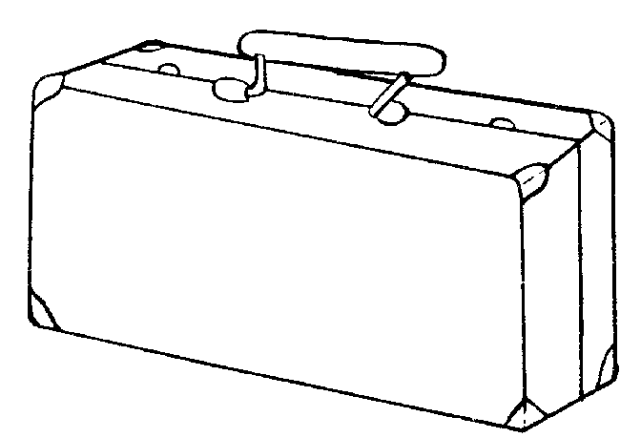

Slide 41
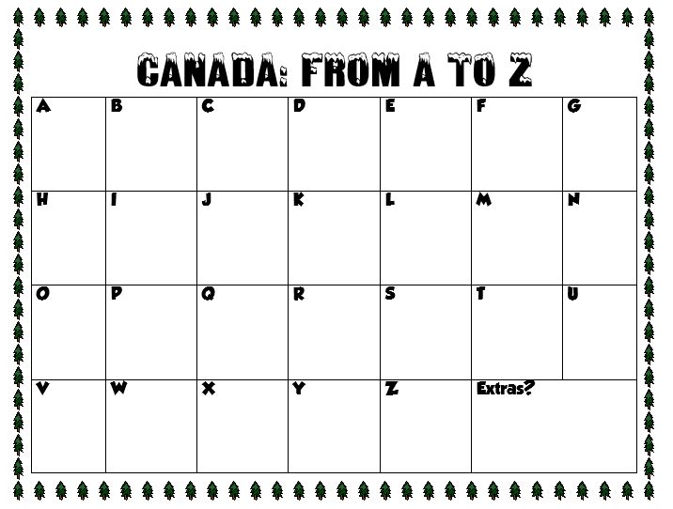

Slide 42
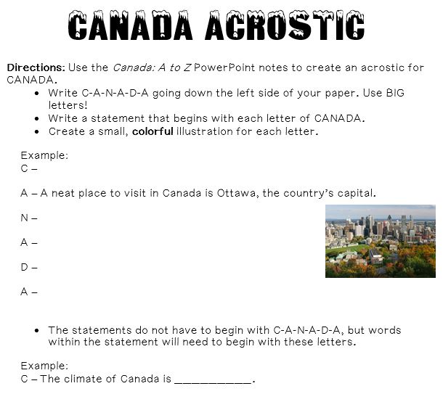

Slide 43
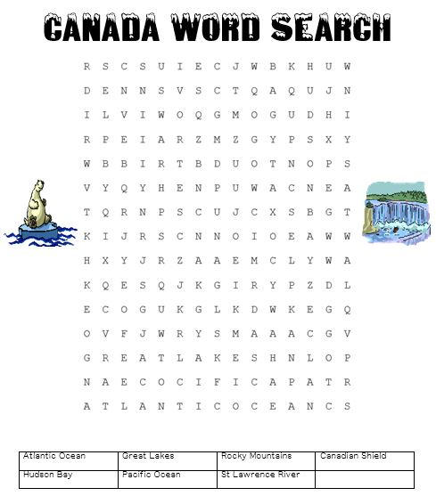

Slide 44
